Slide 2
" In The Name of Allah, The Most Beneficent, The Most Merciful" Nucleus Working Group for Halal Research BY: Dr. Hani M. Al-Mazeedi

Slide 3
Scope
This presentation gives a summary of what a Halal research group minimally should be consist of, and what are the priority of Halal R&D projects.

Slide 4
Content
1) Structure of the nucleus working group
2) R&D priority of Halal projects

Slide 5
Structure of the nucleus working group
Biochemist
Molecular biologist
Veterinarian
Mufti
A) Senior Scientists Group
Fund Raising
Management
Techno-economist
Public relation
Laboratory Technicians
Electrical Engineer
Food technologist
Pharmacologist
B) Supporting Groups

Slide 6
Priority of R&D Halal projects
Animal welfare
Pre and Post-stunning
Halal Analyses & Halal reference laboratory
Halal academic and research centers
Halal Ifta Committee
Managements & Techno economic services
Halal Awareness

Slide 7
Animal welfare
Improvements must be introduced to the infrastructure of animal/bird transportation, handling and slaughterhouses to comply 100% with the Islamic guidelines.

Slide 8
Pre and Post-stunning
Published findings on stunning must be reviewed to investigate those claims that said: stunning is animal welfare. Also, to investigate their adverse health effect, the death biomarkers in the animal/bird to prove that animal was alive or died after stunning and before slaughtering.
May require the involvement of an internationally recognized expert.

Slide 9
Halal Analyses & Halal reference laboratory
We have to develop capabilities in Halal analyses on food and non-food products using sophisticated laboratory equipment such as the use of:
GC, GC-MS, FTIR, PCR, ELISA Test for the determination of Pork Fat, Lard & Lard Derivatives
GC, GC-MS, FTIR for the detection of the presence of Alcohol
FTIR, PCR, ELISA Test for the characterization and comparison of Gelatin from Animal and plant based origin
Immunochemistry test, ELISA, Fluorimetry for protein expression to predict quality of Halal Meat
PCR, ELISA Test, FTIR, DNA test for the detection of Pig’s blood in processed & raw products
GC-MS for fatty acid profiling of meat products

Slide 10
We have to develop a base line data on the analysis of food and non-food products in the country (Total Halal).
We also have to encourage the developing of rapid detection tools for Najis materials.
The presence of Halal reference laboratory will help the public, government control agencies, and private sector in assuring the Halalness of Halal products.

Slide 11
Halal academic and research centers
We have to introduce Halal Departments within government control agencies, colleges and research centers to oversee compliance with Halal guidelines, and to run R&D in Halal field. In addition, the idea of establishing a Halal College in the west is a fantastic idea.
This can be achieved by inviting key leaders of academic and research centers to discover the scientific and research potential in the universities and colleges in the leading countries in Halal research such as Malaysia and Indonesia.

Slide 12
Halal Ifta Committee
A Mufti is a must to direct all activities of Halal activities of groups, and to develop Halal guidelines that are 100% compliance with Shariah.
We have to call upon the formation of a well qualified & reference international Halal Ifta committee that based its decisions on proof from Quran and Sunnah and well established scientific facts.

Slide 13
Fund raising
We have to outsource funds that push forward the wheel of Macro-and MicroHalal*.
*MacroHalal: tackling Halal from the outside, i.e. strategic issues such as stunning law enforcements. *MicroHalal: tackling Halal from the inside, e.g. Halal chain integrity, and Halal researches.

Slide 14
Managements & Techno economic services
We must provide a range of Halal services and Halal marketing managers & techno economic services to support investments in Halal.

Slide 15
Halal Awareness
We have to increase the awareness of Halal among decision makers of Muslim countries with specific emphasis on GCC countries being the main importers from non-Muslim countries.
We have to launch an international multilingual TV satellite channels/websites to increase Halal awareness among consumers worldwide.

Slide 16
Laboratory Technicians
Electrical Engineer
Food technologist
Pharmacologist
Technicians of certain specializations are indeed needed to support R&D Halal projects in for example: laboratory analysis, stunning projects, food processing and drugs applications,

Slide 17
Conclusions
A collaborative efforts of multidisciplinary team is necessary to carry out a successful R&D Halal project.
A supported team is also required to facilitate the needs of Nucleus working group for Halal research.

Slide 18
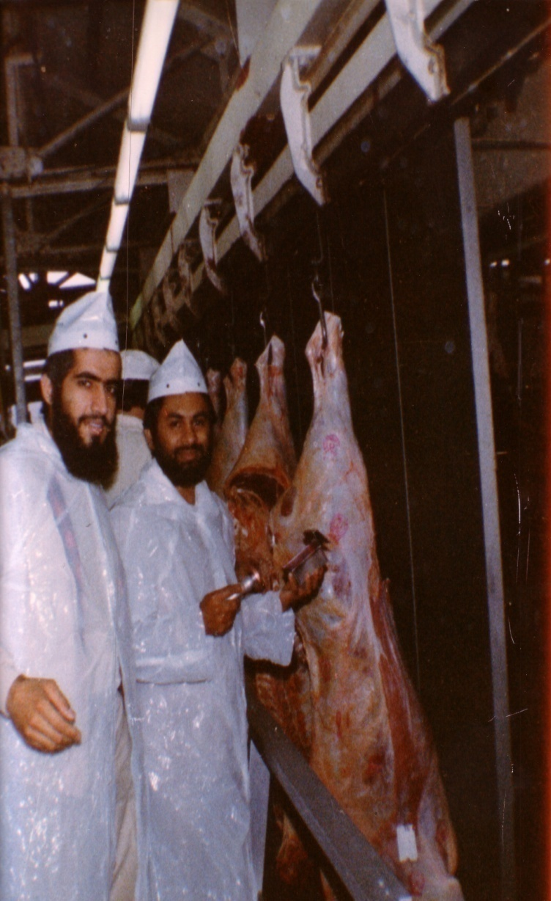
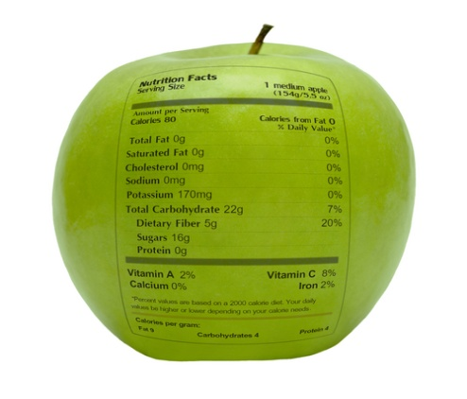
شكراً لاستماعكم
سبحنك اللهم وبحمدك أشهد أن لا إله إلا أنت، أستغفرك وأتوب إليك
د. هاني منصور المزيدي
مع الأخ أمجد محبوب في أستراليا سنة 1981
Dr. Hani Mansour Al-Mazeedi
With brother Amjad Mahboob in Australia in 1981

Slide 19
www.HalalEA.com
Trademarks, icons, images belong to their respective owners.
© Halal Sciences Academy Limited

